Slide 1

The Life Alarm
Help The Helpless
( Yup, the team name is bad. We’re working on it!! )

Slide 2


Mission
Affordability
Efficiency
Portability
This is also our USP. 😏

Slide 3
The Problem
So the basic problem is constant attention that has to be given to bedridden patients and/or the money spent on overcomplicated monitoring systems. This affects the caretaker’s productivity and also financially drains the family.

Slide 4

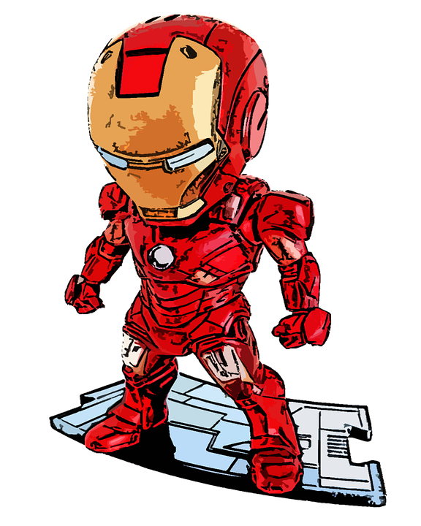
The Solution
So to solve this we decided to make a complete suit that basically helps them walk, jump and probably even fly.
Just kidding. 😂
We’ll show you what we did in the next slide. :)

Slide 5
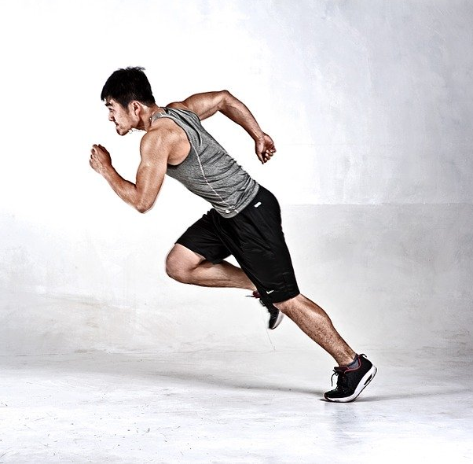
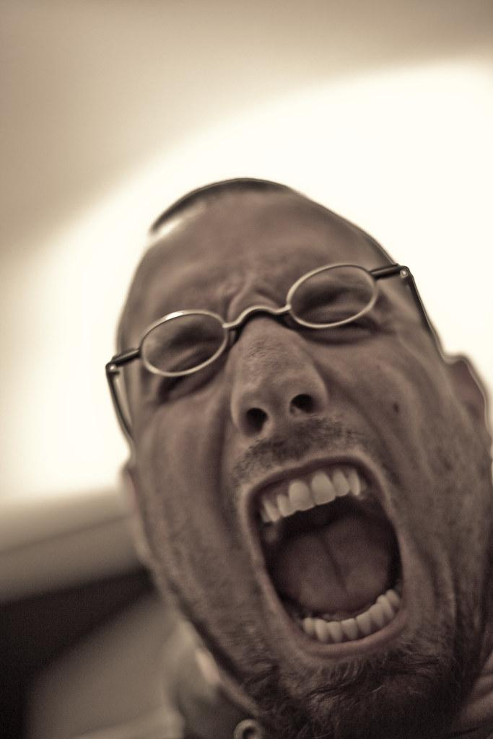

Ease-of-Use at its peak
Step 3
Step 2
Step 1
Caretaker comes and checks on the patient.
The receiver screams.
HELPPPPPPP!!
Patient presses the button or his/her vitals spike.

Slide 6
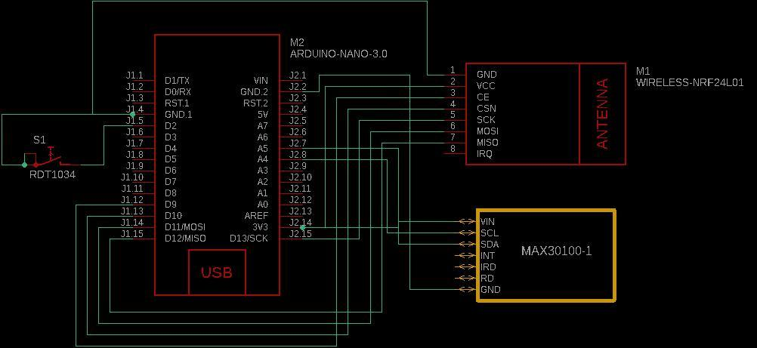
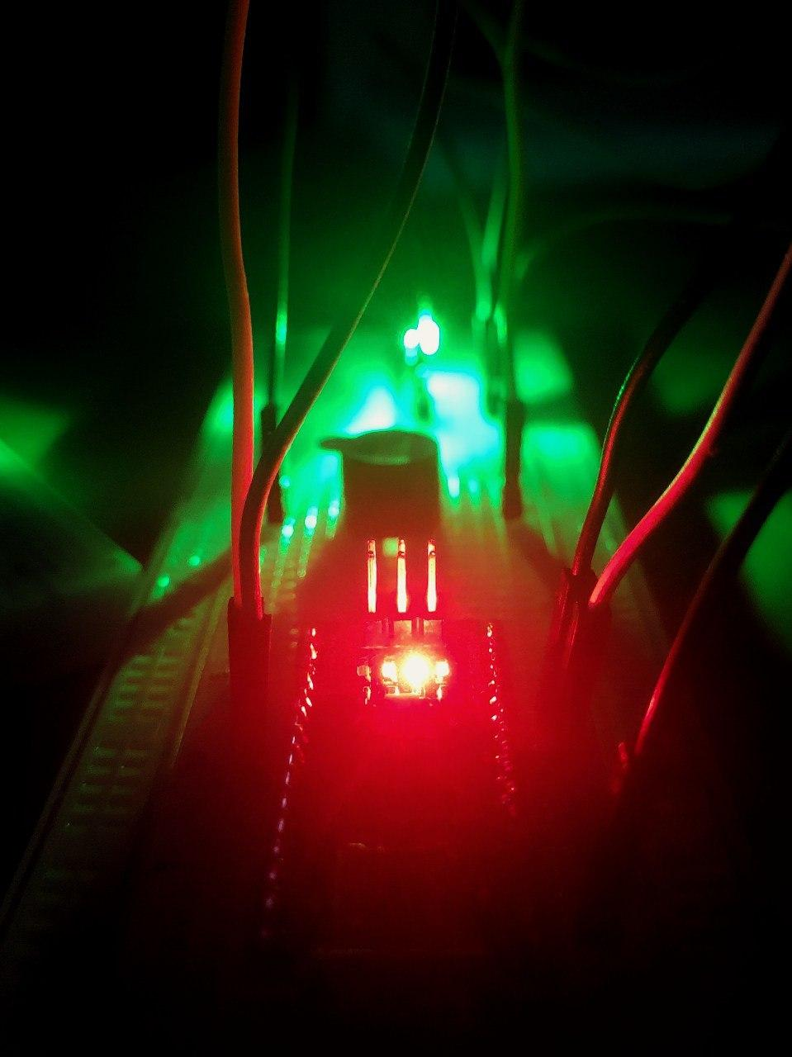
The Technology
Vital Sensors +
Radio Communication
FYI: Not an Arc Reactor. 💠

Slide 7
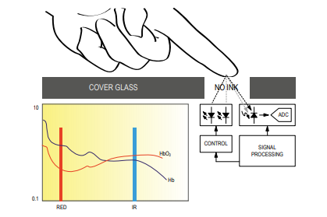
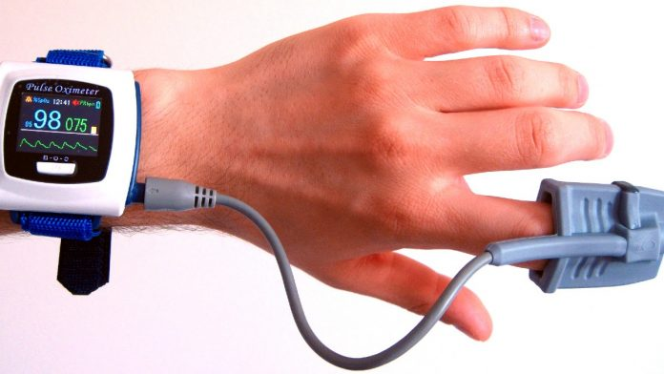
Non Invasive Pulse Oximetry

Slide 8

Expenses
Item | Price
Microcontroller(s) | ₹ 336.00/- (x2)
Radio Transceiver Module(s) | ₹ 73.00/- (x2)
Pulse Oximeter Sensor | ₹ 230.00/-
Total | ₹ 1048.00/-
This is quite important to us.

Slide 9

Product Demo

Slide 10

The
Business Plan

Slide 11
Key Activities
Public Relations.
Collaborate with a medical team.
Gain Funding.
Get CDSCO approval.
What we gonna do.

Slide 12
Key Resources
Human resources, or staff, such as a talented engineers (PCB design experts) and marketing experts.
Financial resources.
Intellectual resources, such as your brand, patents, copyrights, partnerships, and customer databases.
The people we need.

Slide 13
Distribution
Have a physical store in the city centre, and then a website to sell the product online to ship the device directly to your customers.
Having both will help us reach customers beyond our immediate community.
This is how we reach the masses

Slide 14
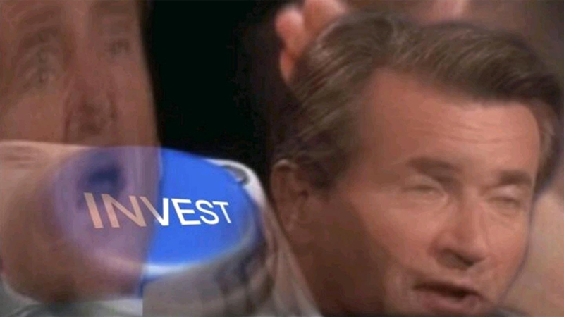
Cost Estimation
Item | Price (₹INR)
Welfare scheme | 1049 +50 = 1099
E-commerce | 1499
Wholesale/Offline | 1599
This is also quite important to us.

Slide 15
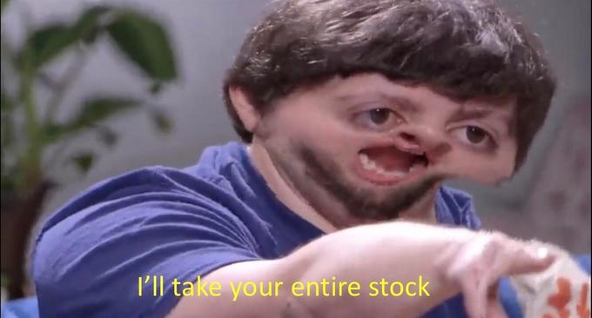
The Investment
65k - Manufacturing cost/Packing
We kinda need some money.
Initial Investment - 1 lakh (60 pieces)
35k - Company registration/ website/Digital marketing

Slide 16

Why now?
Because CORONA.
All the hospitals are trying to send their patients back home to clear out space for COVID patients, and there is a spike in necessity for home surveillance on bed-ridden patients.

Slide 17
The Team
Rishi Vignesh
Bharath Krishnan
rishivnp@gmail.com
bharathkrishnan99@gmail.com
Sai Akhil Yerramsetty
saiakhil.yerramsetty@gmail.com

